Slide 1
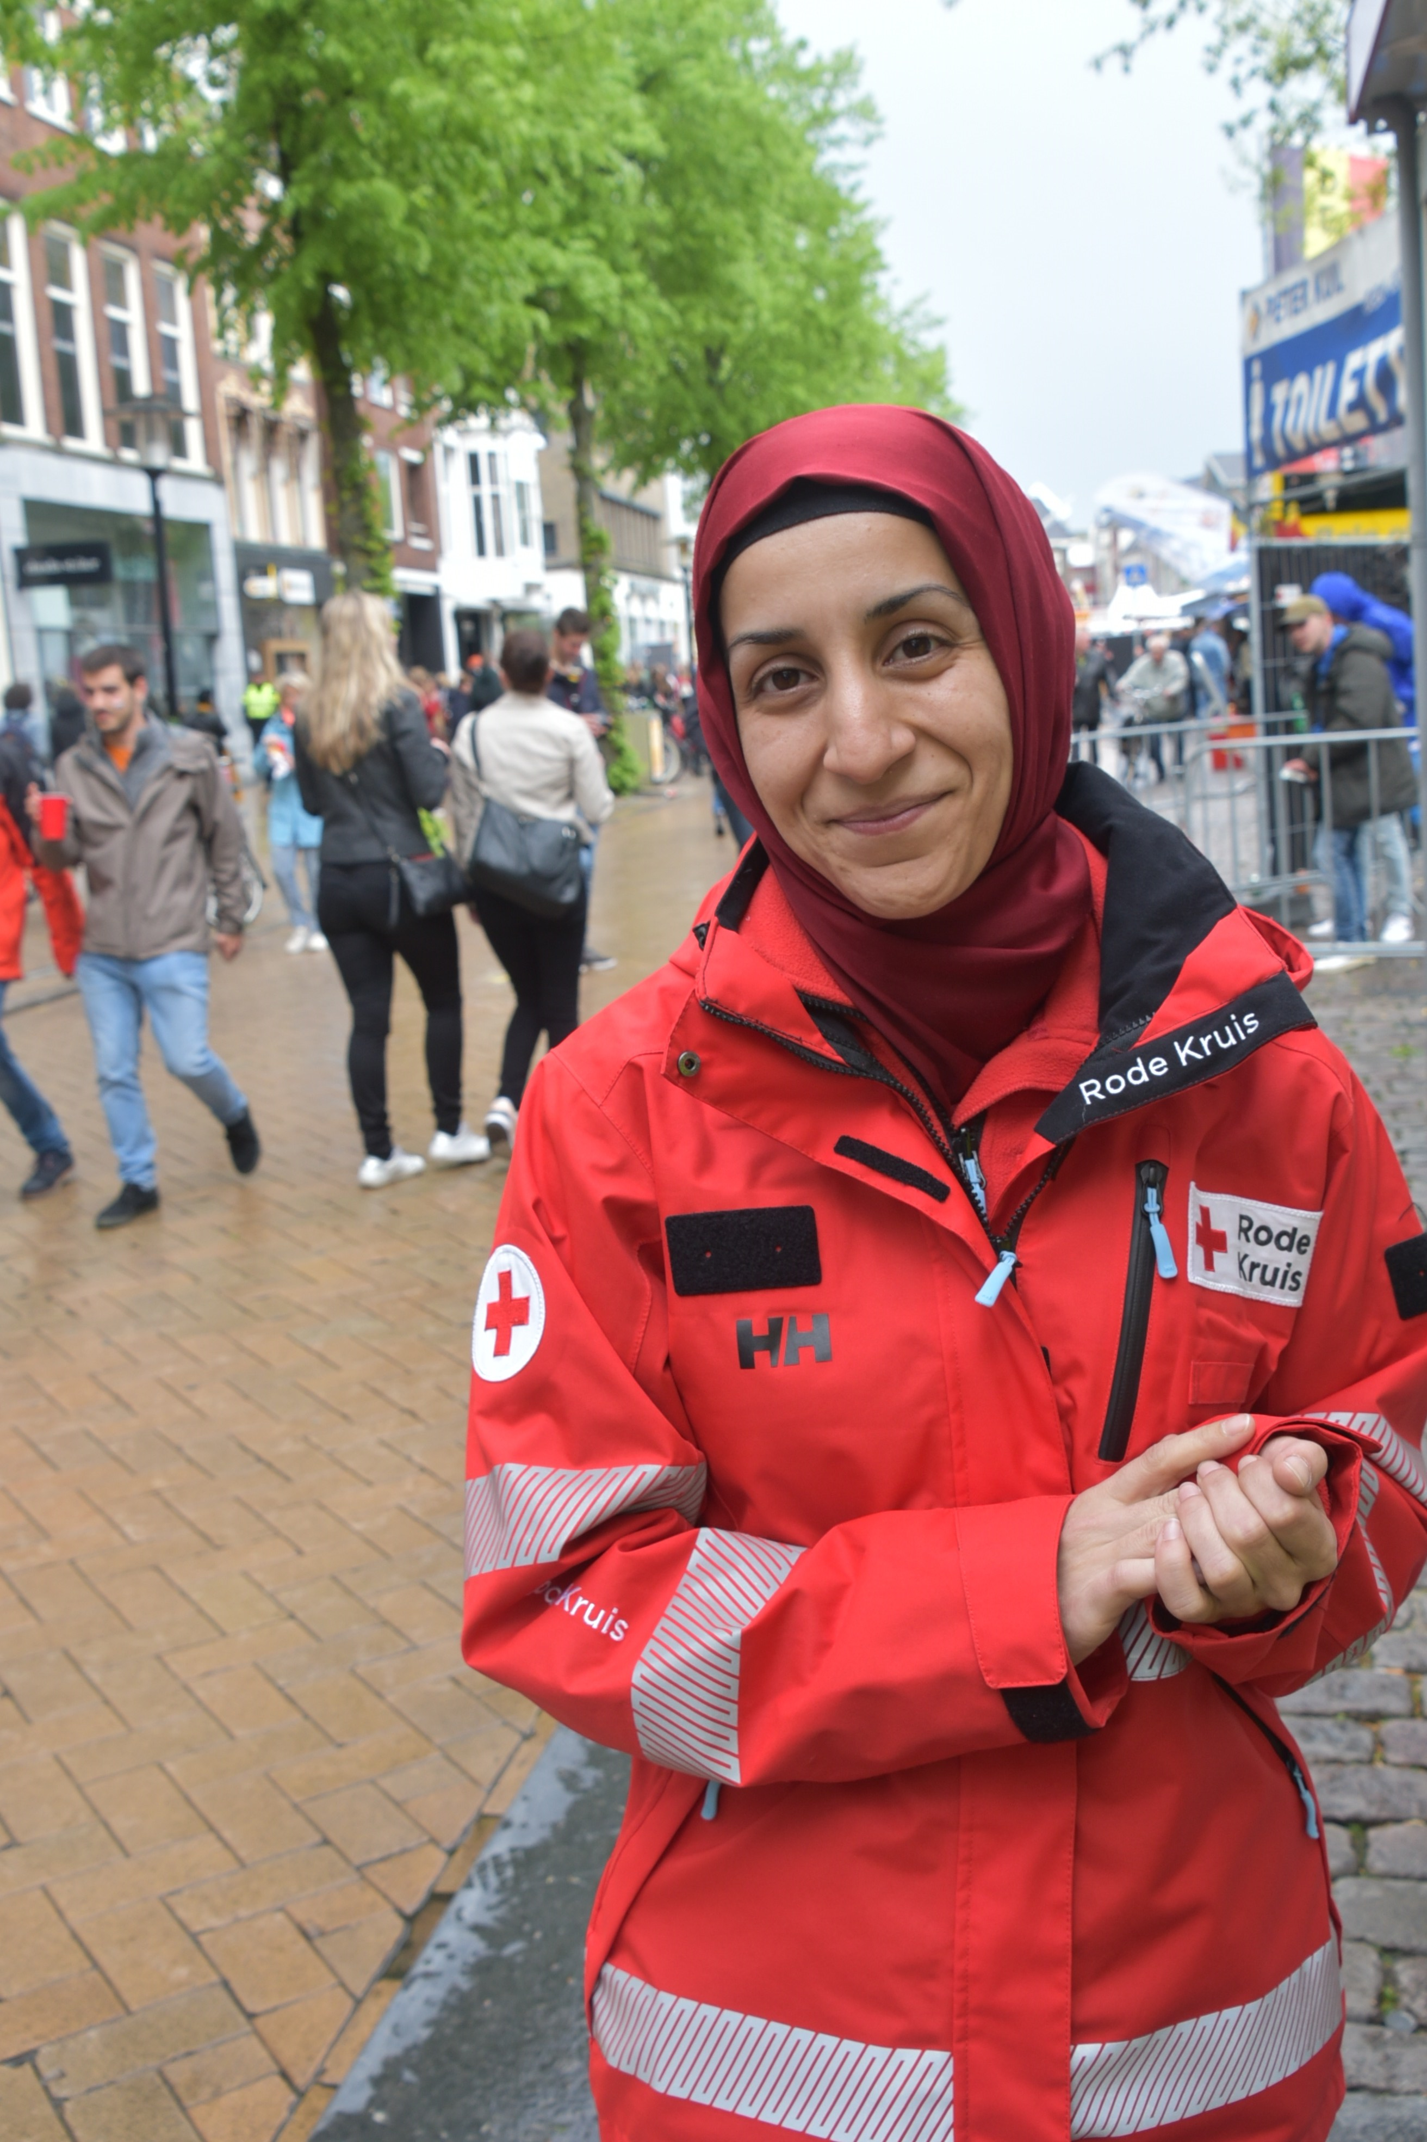
Diversity and Inclusion at the Netherlands Red Cross
The Netherlands Red Cross is committed to fostering a diverse and inclusive organization that reflects the communities it serves. By embracing the unique perspectives and experiences of our volunteers and employees, we can provide better aid and connect with a wider range of supporters. This commitment to diversity and inclusion is central to our mission of being there for everyone in need.

Slide 2
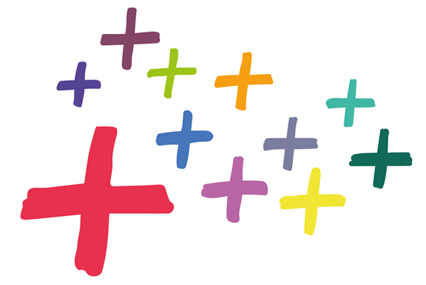
A Powerful Voice for All
Neutral and impartial
In a polarized world, the Netherlands Red Cross is committed to being a powerful, neutral, and impartial voice that serves everyone, regardless of their background or beliefs.
Inclusive advocacy
We advocate for the rights and needs of all people, using our platform to amplify the voices of marginalized communities and champion the cause of diversity and inclusion.
A unifying force
By embracing diversity and fostering inclusion, the Red Cross has the unique ability to bring people together, transcending barriers and uniting our communities in times of need.

Slide 3
Diverse team base
Inclusive recruitment
Ongoing training
Representation matters
We actively seek out staff volunteers from diverse backgrounds, ensuring our recruitment efforts reach a wide range of communities. This includes partnering with local organizations, attending community events, and crafting inclusive job postings that encourage applicants from all walks of life.
Our staff and volunteers receive training not just in core Red Cross skills, but also in cultural competency and inclusive practices. This helps them better understand and serve the diverse populations we work with, providing more personalized and effective aid.
By building a team base that reflects the diversity of the communities we serve, we can better understand their unique needs and tailor our services accordingly. This builds trust and ensures we are a valuable resource for everyone in need.

Slide 4
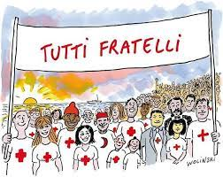
Impactful Initiatives
1
Diversity month
We celebrate diversity and inclusion through an annual Diversity Month, featuring a range of educational and community-building activities that engage our volunteers and employees.
2
Inclusive documentary series
Our documentary series on Henry+ highlights the diverse stories and perspectives of our Red Cross members, showcasing the power of our differences and the unity we find in our shared purpose.
3
Equal pay commitment
We are exploring how to achieve equal pay for men and women at the Netherlands Red Cross, this way we can ensure that all our employees are compensated fairly and equitably regardless of gender.

