Slide 1
Resilience
Psychosocial Support within
The Netherlands Red Cross
2019 - 2023
Current PSO staff:
Liske Hays
Marijke van Thielen
Famke Kamphorst
Ruth van Rhijn
Previous staff:
Carolien Pronk
Madelon Bronner
Esmée Pluijmers

Slide 2
Resolution MHPSS within the Netherlands Red Cross
Team PSO: who are we?
PSS in the NLRC Strategy
Overview of current PSS interventions, including PSS for staff and volunteers
Overview of past PSS interventions
Overview of past campaigns
Other forms of PSS involvement
Thematic Overview

Slide 3
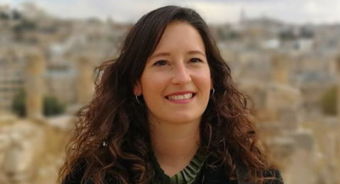
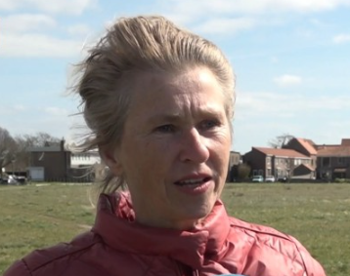
Team PSS: Who are we?
PSS team members:
Liske Hays – Advisor PSS & Focal Person lhays@redcross.nl (since Nov 2023, and PSS Project Support from June 2021 – October 2023)
Marijke van Thielen – National Project leader Psychological First Aid mvanthielen@redcross.nl (since June 2022)
Famke Kamphorst – National Coördinator Team Colleagial Support fkamphorst@redcross.nl (since August 2023)
Esther Lemson – Advisor Project Monitoring, Evaluation and Reporting elemson@redcross.nl (since 2019)
Supportive managers:
Pieter Boot – Head Advice, Policy and Strategy pboot@redcross.nl
Ruth van Rijn – Head Migration & RFL rvanrijn@redcross.nl
Former PSS colleges:
Carolien Pronk – Advisor PSS & Focal person (March 2019 – Oct 2023, and National projectleader support for undocumented migrants April 2014–Feb 2019)
Madelon Bronner - Advisor PSS (Dec 2020- June 2023)
Esmee Pluijmers – Advisor PSS (January 2021 – May 2022)

Slide 4
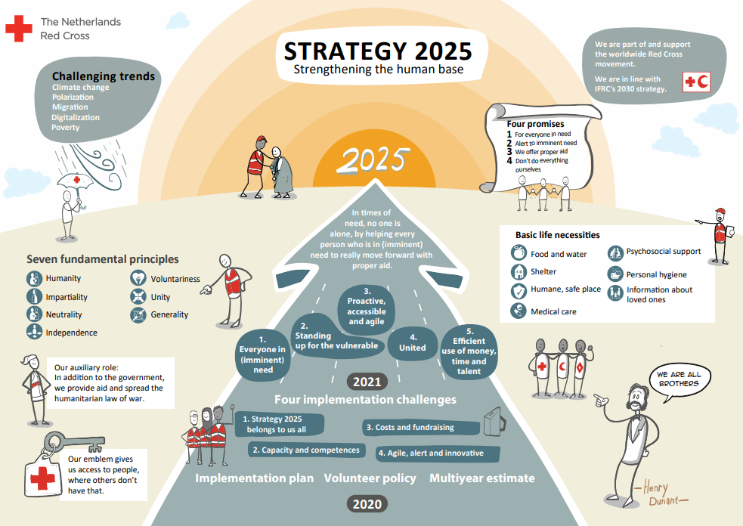

Slide 5
For the NLRC, Psychosocial Support aims to strengthen the resilience of people in need, and the resilience of our staff and volunteers
Resilience is the ability to recover from stress and misfortune

Slide 6
Minimum standard for PSS: Someone is in psychosocial need when they have psychological problems: 1. that disrupt general daily functioning (work, living, social relationships); 2. that cannot be solved by the person himself or with help from the environment (family, friends, neighbors, volunteers, acquaintances); 3. and for which the necessary professional care and support is lacking, as described.
Notes:
To decide to whom to provide PSS for, we developed the NLRC Minimum Standard for PSS, and defined that….:
Someone is in psychosocial need when they have psychological problems: 1. that disrupt general daily functioning (work, living, social relationships); 2. that cannot be solved by the person himself or with help from the environment (family, friends, neighbors, volunteers, acquaintances); 3. and for which the necessary professional care and support is lacking, as described
Described:
Acute care Acute care chain (ambulance care, pharmaceutical care, general practitioner care, specialist medical care, mental health care) is available 24 hours a day, 7 days a week for anyone who needs it with acute, life-threatening psychological problems. Psychosocial support Anyone for whom this is necessary can use this support during or after a disaster or (personal) major event, aimed at strengthening people's mental resilience. General practitioner care Anyone for whom this is necessary can have face-to-face contact with a general practitioner for consultation, treatment and/or referral. Anyone for whom this is necessary can, after referral, contact a mental health practice assistant (POH-GGZ). Social support Anyone for whom this is necessary can make use of this support, aimed at the self-reliance and participation of people with disabilities, chronic psychological or psychosocial problems.

Slide 7
PMER: We measure the outcomes and impact of PSS
Theory of Change of NLRC 2021-2025: “To strenghten the human base”
Ambition of NLRC 2021-2025: “In times of need, nobody should stand alone, since each human being that is in need or might become in need, will get further with proper support.”
PSS Outcomes | PSS Impact
People experience a miminum of psychosocial needs as a consequences of crises or calimities and receive psychosocial support that they need. | Every person in the Netherlands has access to proper psychosocial support.
The help providers and support of the NLRC support the psychosocial wellbeing and health of people in need.
Notes:
Source: ABS-PMER - Indicator handboek.pdf (sharepoint.com)

Slide 8
Assumptions
Actions
People’s own strenght: What can i do myself? How did i deal with challenges in previous situations?
People’s own direction: What works well for me?
‘Do no harm’ principle: Do not disturb people who are doing well, and do prevent the ‘spread’ of intrusive stories, photo’s, videos – to prevent retrautisation of others.
Offer support, in which active listening is key
Explain normal stress responses in emergencies (‘Your response is not abbnormal; the situation is abnormal”)
Show interest and recognise the situation that the person is facing
Help the person to find back calmness and help to create overview in the situationse.
Get back to self controll and self direction.
Refer to other forms of support and care, both formal and informal

Slide 9
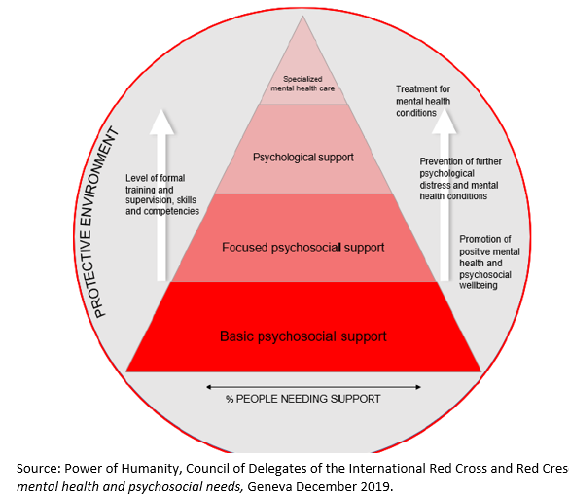
MHPSS Pyramid (source: IFRC PS Center)
The Netherlands Red Cross focusses on the utter two layers of Pyramid, with basic and focussed psychosocial support

Slide 10
NLRC MHPSS Strategic House
Mission
To Strengthen the resilience of
People in need and that of our staff and volunteers
Vision
Resilience it the capability to deal with stress and misfortune
We strengthen the resilience by offering psychosocial support
Based on the 5 principles of Hobfoll: safety, calmness, connectivity, resilience and hope
Strategic pillars
Psychosocial Support for people in emergencies
Strengthening the resilience of people in need and in vulnerable situations
Strengthening the resilience of our help givers
Being there among the first ones in emergency situations to provide support
Providing Psychological First Aid through our volunteers and staff
Future: Structurd and standartised agreements with partner organisations
Focussed psychosocial support with national direction, regional and local implementarion and PSS specialists
Public campaigns for people in vulnerable circumstances
National wide structure to provide Team Collegial Support in which trained volunteers offer peer support to collegues and are present during high risk shifts
Prevention of psychological problems thorugh breaking the taboe, reassuring quality standards and ensure self-care
Actions
Active listening, Support, Sharing Knowledge, Provision of tools and training skills,
reenforcing people’s own strengths and sources of support, recognizing, referring to proper care
Values
Humanity – Inpartiality – Neutrality – Independence – Voluntary – Unity – Generalit

Slide 11
3. Overview of current psychosocial support intervention based on the strategic PSS-pillars
Basic Psychosocial Support for people in emergencies
Focussed PSS: Strengthening the resilience of people in need and in vulnerable situations
Strengthening the resilience of our help givers

Slide 12
Pillar 1 Basic psychosocial support for people in emergencies
One of the first to be present in acute emergencies for help (Emergency Aid & Population Care).
All Red Cross aid workers have basic knowledge of Mental First Aid (first level of the pyramid)

Slide 13
Pillar 1 Basic psychosocial support for people in emergencies
Ensuring basic PSS in all NLRC interventions (tailor made, since 2019)
E-module PSS (30 min) – for all NLRC 13.000 volunteers & 600 staff, since 2021)
Podcasts PSS by and for students: two series of episodes with PSS topics (since 2021)
Podcasts PSS for staff & volunteers: three episodes (since 2023)
Microlearning for staff & volunteers: Self-care and Resilience & Resilience (since 2023)

Slide 14
Pillar 1 Basic Psychosocial Support for people in emergencies
Physical & practical PSS trainings for volunteers and staff working:
With victims of human trafficking
With undocumented migrants
With asylum seekers and Ukraine displaced person at reception locations
At helplines (including phone lines, WhatsApp helplines and website)
At NLRC voluntary support desks
As first aid trainers
As team leaders in districts

Slide 15
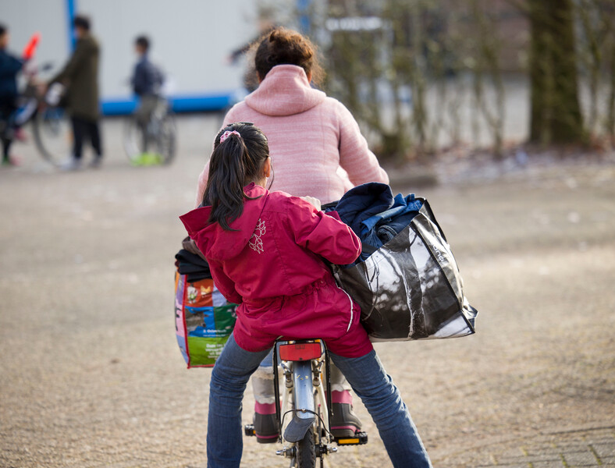
Pillar 2 Focussed PSS: Strengthening the resilience of people in need and in vulnerable stuations
Assistance by PSS-trained volunteers for specific vulnerable groups, Targeted Psychosocial Support (second level of the pyramid) by:
2.1 Psychological First Aid for asylum seekers, displaced persons
2.2 Life Skills workshops for undocumented migrants, victims of human trafficking, asylum seekers
2.3 Psychosocial Support ‘On Track’ in reception locations
2.4 Psychosocial Support ‘Look after another’ network for all persons in the Netherland
Notes:
Kwetsbare groepen: ongedocumenteerden, EU arbeidsmigranten, slachtoffersmensenhandel , mensen multiproblematiek

Slide 16
2.1 Focussed PSS: PFA in reception locations for asylum seekers and Ukrain displaced people
What: PFA in one-to-one or max 4 persons
Who: 40 trained volunteers and 60 trained temporary workers
Where: Active in 30 reception locations of the NLRC
Methodology: PFA developed by IFRC PS Center: Look, Listen, Link & (cross-cutting) Strengthen Resilience
Recent pilot: training colleagues of the municipalities in PFA in Reception Shelters

Slide 17
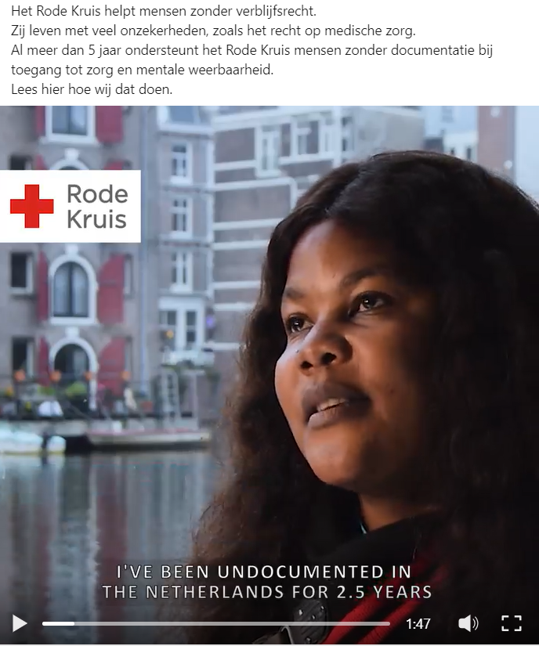
2.2 Focussed PSS: Life Skills workshops for undocumented migrants, victims of human trafficking and asylum seekers
What: Workshops with the aim to help participants develop their skills to effectively protect their health and well-being.
Who: Around 50 trained volunteers.
Where: Active in and working together with several reception locations for asylum seekers and emergency shelters, and partner organizations in around 6 districts, including Detention Center Rotterdam.
Methodology: Interactive workshops session with a thematic focus, including access to health care, healthy habits, clear communication, using your talents and looking forward

Slide 18
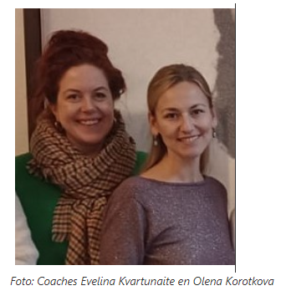
2.3 Focussed PSS: Coaching voor Oekraïense ontheemden
What: Consultation hours
Who: provided by 2 Ukraïan/Russian and 1 Arabic coachs
Where: in several reception shelters in two districts
Methodology: Supportive confidential conversations based on accessible contact in which people share their worries and challenges. The psychosocial support workers share their cultural and linguistic background.

Slide 19
2.4 Focussed PSS: ‘Look after another’ network for persons with multiple problems in the Netherlands
What: To provide psychosocial support for people with limited social network, so that nobody is standing alone in times of need -aiming to:
Make people feel supported
Help them to access to proper care and support
Meet their basic needs
Who: Volunteers and staff of the Helpline, in districts and trained and skilled coaches
Methodology: Psychological First Aid, and referrals internally (mainly food support) and externally (to care)

Slide 20
Pillar 3 Strengthening the resilience of our help givers
National wide Team Colllegial Support structure: trained volunteers that provide peer support to NLRC colleagues after having experienced an impressive situation and being availeble during high risk shifts
Attention for precare an aftercare

Slide 21
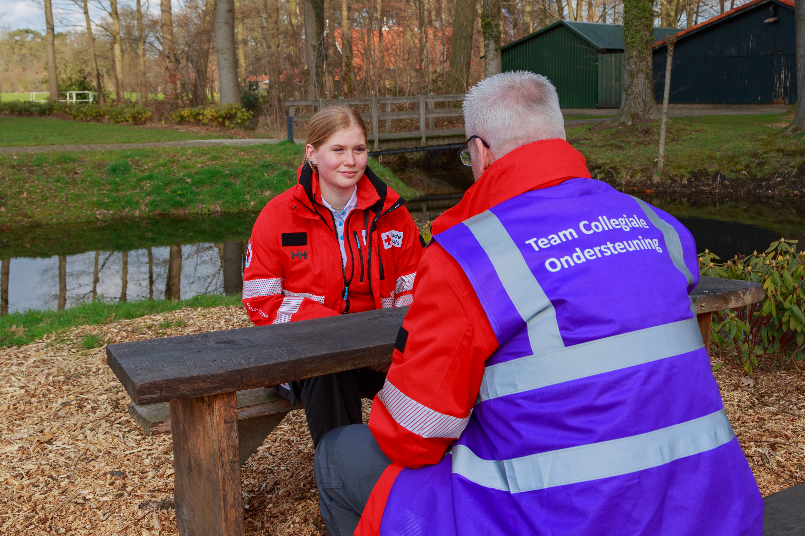
3.1 Peer Support Team
What: one-to-one conversation aimed to strenghten resilience, so that person can recover best as possible from the stress and setbacks caused by a major, or a serie of, event(s).
Who: a form of peer support by and for Red Cross colleagues
Where: Through a national wide number
Methodology: Peer support with focus on:
Connecting with the person
Recognition of the situation and impact on the person
Identifying the next steps that the person can undertake, including offering information about support within the NLRC and elsewhere
Call 085 760 5798 and speak with peers
Direct, close by and confidential
Notes:
Importance of limitation: for therapy, trauma treatment or formal counselling, people should go to their GP

Slide 22
3.2 Strengthening resilience of our help givers: Self care
Self care plan, followed by example of the Flamish Belgian RC
Workshops and information sharing as part of trainings, gatherings and intervision sessions
Notes:
Een goede balans vinden tussen energievreters en enegriebronnen.
Deel uitmaakt

Slide 23
3.3 Pillar 3 Strengthening the resilience of our help givers: After care for NLRC help providers
1. Direct manager
2. Peer Support Team +31 857 60 5798 (24/7 reachable)
3. GP for supportive talks with assistant and referrals for research and treatment
Externally: call or chat with a MIND psychologist (9AM-9PM) without payment​
Dp you doubt your own wellbeing of that of other people in your surrounding, please do not hesitate and ask for professional support

Slide 24
Other current PSS activities (apart from interventions)
Consultation group existing of district managers, coordinators and volunteers
Initiating and facilitating intervision reflection meetings within the National Support department

Slide 25
4. Overview of past PSS interventions 2019- 2020
during COVID19
4.1 Development of Pilot ‘Looking after another’ network for people with multiple needs, providing PSS support through skilled ‘quarantaine’ coaches (2019-2020)
4.2 WhatsApp Helplines in multiple languages for migrant (communities) in the Netherlands, including Portugese, Arabisch, Maroccan, Turkish and Chinese (2019-2020)
4.3 Referring young people with PSS needs to formal care givers (2019-2020)

Slide 26
4. Overview of past PSS interventions 2020 - 2021
4.1 Think Tank ‘Mental Wellbeing of young adults’ to research the PSS needs and possible solutions of young adults between 18 and 27 years (2020-2021)
4.2 Pilot project ‘Perspective’ to offer young adults with deprived social-economical backgrounds a stage within the NLRC (2020-2021)
4.3 Pilot project ‘Team-Up for children with deprived social-economical migrant backgrounds in Rotterdam (2020-2021)

Slide 27
5. Overview of Campaigns & Video’s 2019-2023
Skip the corona dip
Video Stress & Healthy habits (self care for migrant and other people in the Netherlands)
World Mental Health Day
Blue Monday

Slide 28
Skip the corona dip campaign Winter December 2021
Notes:
Vind je eigen superpower! - Rode Kruis Nederland
Skip de coronadip, 30 december 2021:
aftrap van #skipdecoronadip marathon editie; video kunnen jullie vinden middels deze link: https: //youtu.be/9L1Zd3Kb4SA
een link naar toelichting campagne bij ad live nieuws updates: https://lnkd.in/dU3vJNn8

Slide 29
Video ‘Stress & Healthy Habits’ – Strenghening Selfcare for migrants in the Netherlands
Notes:
Rode Kruis Workshop Stress & Healthy Habits– Arabic (INT) https://youtu.be/vHcgVAUdeuc
Rode Kruis Workshop Stress & Healthy Habits – Arabic (NL) https://youtu.be/d4db4DWkNuo
Rode Kruis Workshop Stress & Healthy Habits – English (INT) https://youtu.be/4rkXR3kzLbw
Rode Kruis Workshop Stress & Healthy Habits – English (NL) https://youtu.be/dl_p6PAOA2o
Rode Kruis Workshop Stress & Healthy Habits – French (INT) https://youtu.be/PcjDyPxyyvo
Rode Kruis Workshop Stress & Healthy Habits – French (NL) https://youtu.be/CAzap6hGdUo
Rode Kruis Workshop Stress & Healthy Habits – Dutch (NL) https://youtu.be/bLA1uWixSRw
Rode Kruis Workshop Stress & Healthy Habits – Portuguese (INT) https://youtu.be/0gbgswNVc9Q
Rode Kruis Workshop Stress & Healthy Habits – Portuguese (NL) https://youtu.be/jKH_k8cBenk
Rode Kruis Workshop Stress & Healthy Habits – Spanish (INT) https://youtu.be/RvMkzfQnyZU
Rode Kruis Workshop Stress & Healthy Habits – Spanish (NL) https://youtu.be/5vuFBRJIMZE
Rode Kruis Workshop Stress & Healthy Habits – Tigrinya (INT) https://youtu.be/7W-ojGl0BSM
Rode Kruis Workshop Stress & Healthy Habits – Tigrinya (NL) https://youtu.be/WDA-2qO5mxI
Rode Kruis Workshop Stress & Healthy Habits – Dari (NL) https://youtu.be/Wnf_fhAhaPE
Rode Kruis Workshop Stress & Healthy Habits – Ukraian (INT) https://youtu.be/Zt_HfeYT4GM

Slide 30
Find your own inner strength! December 2021
Notes:
Vind je eigen superpower! - Rode Kruis Nederland
Skip de coronadip, 30 december 2021:
aftrap van #skipdecoronadip marathon editie; video kunnen jullie vinden middels deze link: https: //youtu.be/9L1Zd3Kb4SA
een link naar toelichting campagne bij ad live nieuws updates: https://lnkd.in/dU3vJNn8

Slide 31
Everybody is a superhero
What are your super powers?
Do the super power-challenge!
Name 3 positieve characteristics of your neighbour, and ask him or her ‘what are yours?’

Slide 32
6. Overview of other forms of other PSS involvement
Participating in the MHPSS European Network since 2016 (by Sabrina Poorte, Carolien Pronk, Liske Hays)
Steering member 2019-2023 and co-chair 2021-2023 of the MHPSS European Network 2019-2023 (by Carolien Pronk)
Participants of working groups:
Prioriy action area 1 – 2021-2023

Slide 33
Thank you!
PSS team members:
Liske Hays – Advisor PSS & Focal Person lhays@redcross.nl (since Nov 2023, and PSS Project Support from June 2021 – October 2023)
Marijke van Thielen – National Project leader Psychological First Aid mvanthielen@redcross.nl (since June 2022)
Famke Kamphorst – National Coördinator Team Colleagial Support fkamphorst@redcross.nl (since August 2023)
Esther Lemson – Advisor Project Monitoring, Evaluation and Reporting elemson@redcross.nl (since 2019)
Supportive managers:
Pieter Boot – Head Advice, Policy and Strategy pboot@redcross.nl
Ruth van Rijn – Head Migration & RFL rvanrijn@redcross.nl

Slide 34
Thank you! voor een ander voor jezelf voor elkaar

