Slide 1
Community Engagement and Partnerships Latino Engagement Pilot Program Overview
Supporting Regions to become the trusted, welcomed service provider and organization of choice for the Latino Community.

Slide 2
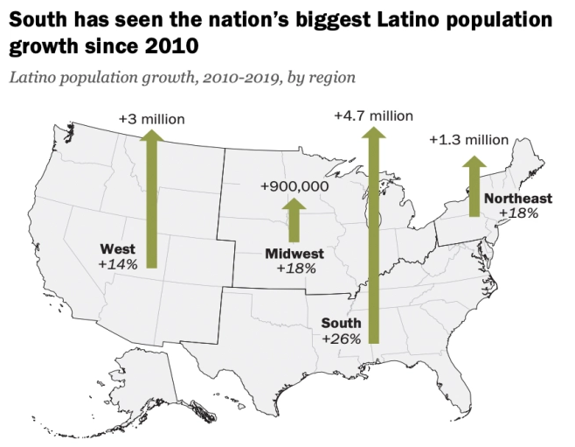
Why Focus on Latino Communities…An Urgent Disparity in Access
1. Latinos are the largest and fastest growing minority demographic in the USA
4. Latinos are living in the most climate affected and disaster-prone regions in the USA while experiencing significant pre-disaster cost burdens.
60.6 Million Latino & Hispanic People
18.5% of total US Population
54% of Latinos rent vs 28% of whites
56.9% of Latinos spend over 30% of income on housing
12% do not have access to a car
(Hispanic Access Foundation)
2. Significant barriers limit access to Red Cross services such as language, trust, relationships (community connections), and access to information
5. Anti-immigrant policies and sentiment such as the Family Separation Policy (2018-present) further isolating some immigrant Latino populations within the USA
3. Latinos and black people together comprise 55% of coronavirus cases, nearly double their U.S. population makeup, according to CDC data released June 15, 2020.
5,500+ Children separated from families
(NY Times)
6. Latinos are volunteering at comparable hours to other communities…but t not always captured by formal measures
State | Latino Population in State | Latino COVID-19 Cases
Utah | 14% | 26.6%
Oregon | 13% | 35.5%
Washington | 13% | 38%
California | 39.3% | 60.4%
2015 Data (CNCS) | White | Black | Asian | Hawaiian/API | Latino
Volunteering by Race | 26.7% | 19.2% | 18.4% | 24.4% | 15.5%
Median hours per year | 50 | 52 | 40 | 48 | 50
2

Slide 3
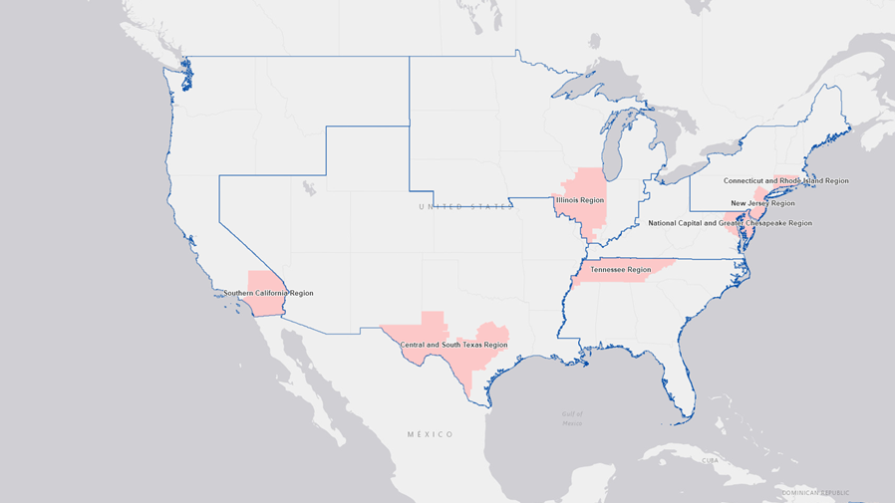
LEI Pilot Program CY 2021

Slide 4
Latino Engagement Pilots
The purpose of this pilot is to develop a well-defined and repeatable community engagement process for the Red Cross to establish relationships within the Latino community in a manner that will build trust, improve access to Red Cross services and result in the delivery of services to more Latino and Hispanic communities. Through these pilots the Red Cross will:
Serve more Latino and Hispanic clients, offering end-to-end client experiences and outcomes supported by bilingual and bicultural staff and volunteers - beginning with all disaster services.
Experience greater connection to the Hispanic community as evidenced by an increase in the number of Spanish speaking and racially diverse Red Cross volunteers; greater level of blood donations, and participation in preparedness and training programs.
Strengthen the resilience of communities as a result of enhanced service delivery and community engagement.
Objectives
Build Trust | Improve Access | Expand Service Delivery | Ensure Excellent Client Experience
Deepen current and develop new partnerships with affiliates of national and local community-based organizations serving the Latino and Hispanic community. Build trust through collaborative engagement, mutually beneficial partnerships and client-focused service delivery to Latino and Hispanic communities. | Increase pathways for Latino & Hispanic communities to access Red Cross information and services in a culturally and linguistically appropriate fashion. Improve access through increased two-way information, education, and communication (IEC) to build relationships with community leaders that motivates volunteerism and collaborative action. | Strengthen the CEP workforce through a clearly articulated training and development program, aiming their efforts and those of the programs to serve more Latino & Hispanic communities in need. Adapt Steady State Standard & Procedures, Job Tools and doctrine materials to effectively deliver the range of humanitarian services valued by the community. | Through client satisfaction metrics, ensure Latino & Hispanic clients have an end-to-end experience that is linguistically appropriate and culturally resonant. Regions engage community leaders, their constituents and partners in a continuous improvement process that leads to client focused service delivery adaptation (i.e. inclusion of Latino food vendors in vendor contracts)
3

Slide 5
Elements of Success
Critical factors to ensure capacity and capability needed to reliably accomplish our mission as a partner with the Latino Community.
CEP workforce has the composition, tools, knowledge and skillsets to effectively engage the Latino community, partner with the Latino community and deliver services.
Strengthened CEP workforce
Active engagement with Latino Communities
Culture of Community Engagement
Culturally competent service delivery
Through an increase in communication, awareness and partnership, the Latino community is consistently included in steady state service delivery plans; and, programs are tailored linguistically and culturally, as appropriate, to effectively deliver Red Cross services.
Regional Leadership team and direct reports value engaging the Latino community in a participatory fashion to meet mutual goals.
Staff are aware of cultural nuances and able to utilize culturally competent best practices to partner, build trust and maximize Latino community access to Red Cross services.

Slide 6
Tactics to Achieve Elements of Success
Build, train and develop culturally and linguistically competent workforce to provide Red Cross services to Latino communities
Integrate LET into the quarterly workforce planning process led by the Regional Volunteer Services team.
Train LET in roles to fulfill the region’s Latino engagement strategy.
Identify priority communities and partners to participate in pilots.
Utilize available data to understand where Latino communities exist in their regions.
Conduct a partner assessment process to identify new and existing Latino organizations and leaders who will help build trust and improve access in Latino communities.
Conduct meetings and outreach in priority communities to identify service delivery needs.
Build a culture of community engagement through active engagement: meetings, outreach, facilitating partnerships
Establish trusted relationships with Latino leaders in priority communities and with local organizations.
Increase service delivery in identified priority communities
Utilize available data and mapping tools to understand scope and depth of Red Cross regional service delivery and where it needs to be expanded.
Collaborate with Latino communities to ensure excellent client experience.
Share key Red Cross communication materials that will be translated into Spanish and other relevant languages.
Measure progress, adapt as necessary and improve service delivery offerings
Utilize systems of record in Disaster Cycle Services to build a performance measurement dashboard to build accountability for service delivery and client experience.

Slide 7
Measures of Effectiveness
Measures are divided into two categories Leadership and Program Management. Leadership measures are for REs and NHQ senior leadership. Program Management Measures are the responsibility of the Regional CEP Lead with support from DCS CEP Team.
Leadership
# and strength of new or expanded partnerships serving the Latino Community
# of people completed CEP training package and serving as effective CEP members
# of new Spanish speaking volunteers, blood donations and financial donations from priority communities
Extent to which the LEI initiative is viewed by ARC teammates as a positive element of the region’s diversity environment
Program Management (in conjunction with Regional CEP Lead)
Infrastructure
% of LET Staff recruited, trained and supporting mission delivery
# total volunteer hours for regional LET workforce
Outreach & Activities
# of community meetings held
# of community outreach events conducted
# and form of communications (video, social media, or print) tailored to the Latino & Hispanic community
# and type of communications products translated for community
Inclusion
At least 80% of Regional community partners report satisfaction with or make recommendation to improve RC CEP activities
Outcomes
% increase in services in priority communities (i.e. home fire response, DAT calls, blood donations, financial donations, participation in the mission)
% increase in Spanish speaking workforce

Slide 8
Products and Tools
The following is a list of products that have been developed to support pilot execution for one year:
Steady State Standards and Procedures and supporting doctrine bulletins
8 Training modules focused on knowledge, attitudes and best practices to effectively engage the Latino community.
3 Job Descriptions and Steady State Table of organizations
Customized RCView Mapping Tool for each Pilot Region.
CEP Partner Questionnaire
CEP handheld field survey and tracking tool

Slide 9
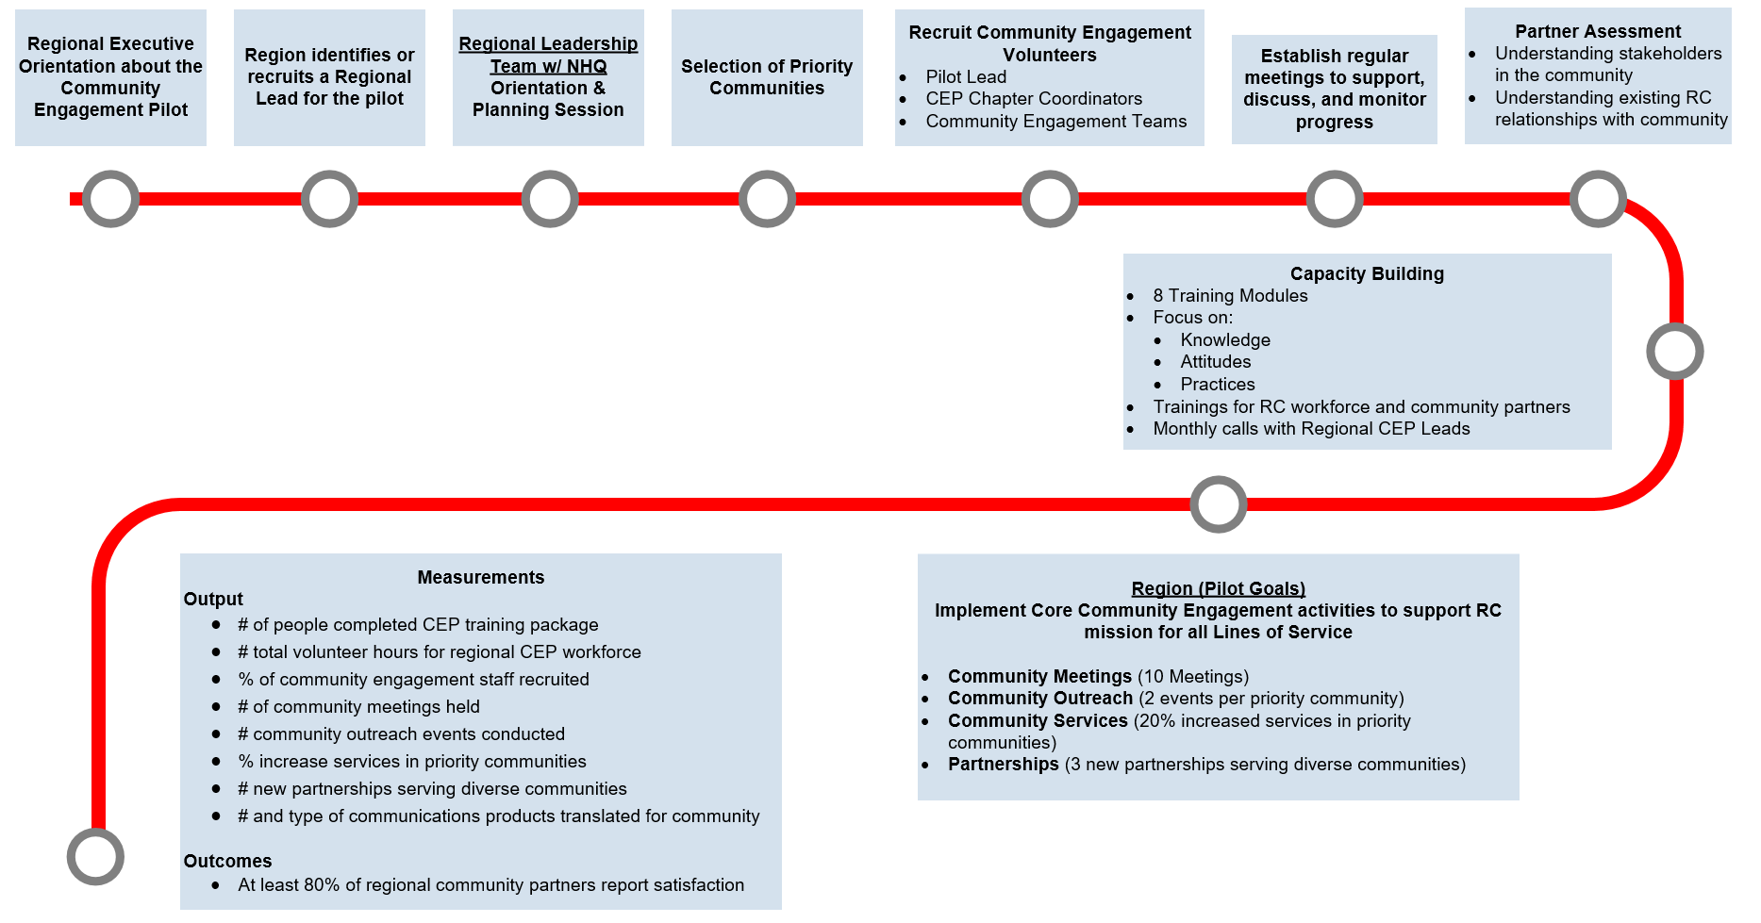
Process & Timeframe - Regional Activities
Nov 2020
Dec 2020
Dec 2020
Dec 2020
Dec 2020
Jan 2021
Feb 2021
Mar 2021
Year End
Data Collected Monthly
*Regional Executive orientation and ongoing consultation will include key leadership staff: Regional Communicator, Regional Development Officer RDSE, RVSO and key SAF/ISD & Training Services personnel.
9

